Slide 1

Strategic job plan
Nandhu Krishnan Muralidharan Nair
MGMT 6450A OCT/18/2023

Slide 2
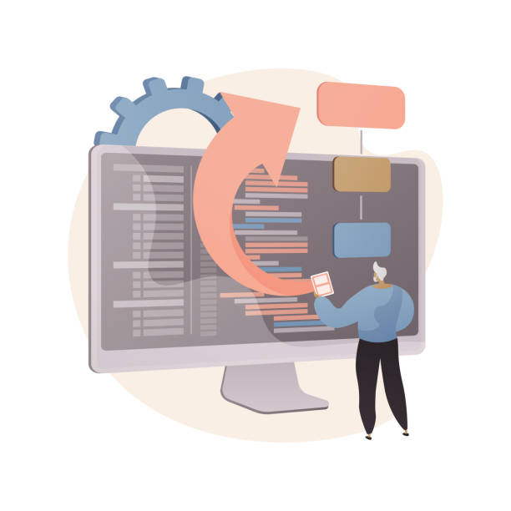
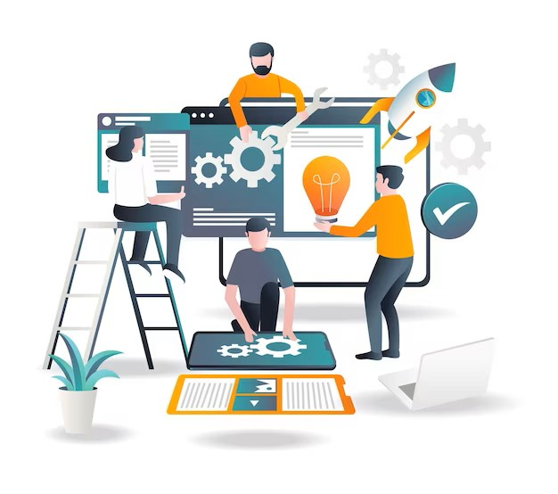
Agenda
Introduction​
Self Assessment
Strategy Job search plan​
Develop a Learning plan
Action plan
Summary​

Slide 3

Introduction
Nandhu Krishnan, MBA student specializing in digital transformation. Bachelor of Business Administration and Postgraduate Diploma in Supply Chain Management. I've decided to pursue a thrilling new technology job after working in business. I'm excited to apply my digital transformation knowledge and experience to the fast-changing IT business. My supply chain management knowledge and love for technology will allow me to make a significant contribution to this business, and I am excited about the challenges and opportunities ahead.

Slide 4
self-assessment
Understand yourself
Understand the Market
Promote yourself
Define Strategy
have a diverse academic and professional background
passion for data science and technology is clear
career transition aligns with your values and motivators
Pursuing an MBA in digital transformation aligns my skills with my career goals
Intent to leverage existing skills in digital transformation.
A unique blend of supply chain expertise and passion for technology for meaningful contributions.
Intention to transition implies awareness of tech sector opportunities.
The pursuit of an MBA in digital transformation shows an understanding of market demand.
Share a plan to acquire the necessary skills and embrace new challenges.
Showcase dedication and commitment to your career transition.
Highlight supply chain and business administration knowledge are valuable in the tech sector.

Slide 5
Strategy Job search plan
Identify Organizations
Continuous Learning
Customize Resume and Cover Letter
Target companies in the digital transformation, technology, and data science sectors that align with your career goals and values
Stay updated by taking online courses, attending workshops, and earning relevant certifications to enhance your skills
Tailor your application materials to emphasize your evolving skills and passion for data science and technology and update linked in
Network
Regular Review
Connect with professionals in these sectors through industry events, LinkedIn, and alumni connections to expand your network
Regularly review and adjust your job search plan as you gain experience and expand your skill set to ensure alignment with your evolving career goals

Slide 6
Develop a Learning plan
Specific Goals
Prioritize
Realistic
Define clear goals for skill improvement and knowledge acquisition.
Identify and prioritize areas of improvement based on relevance.​
Set achievable timelines for goal completion and progress tracking.
Online Resources
Utilize online courses, tutorials, and industry resources for learning.
Seek feedback from mentors, peers, and professionals for continuous improvement.

Slide 7
Action plan
Short Term
Long Term
Enhancement of Skill: Make a project portfolio and sign up for online courses.
Networking: Update your resume, join online groups, and go to events.
Personal Projects: Engage in useful data science initiatives.
Advanced Education: Enroll in graduate-level or advanced courses.
Specialization: Concentrate on fields of data science.
Professional Experience: Look for entry-level jobs and internships.
Locate a mentor in the data science industry.
Continuous Learning: Keep abreast with technological advancements and give back to the community

Slide 8

Summary
To sum up, my transition from a supply chain management background to a future in data science and technology is a dynamic change that is in line with my goals and passions. My short- and long-term action plans offer a path to gaining the required knowledge, creating a solid network, and consistently adjusting to the IT industry's changing conditions. I'm thrilled about the challenges and opportunities that lie ahead and am convinced that I can make a significant difference in this sector that is always changing with effort and perseverance.

Slide 9

reference
https://business.udemy.com/request-demo-business-courses/?utm_source=paid-search&utm_medium=google&utm_campaign=search-nb-professionaldevelopmentamer&utm_content=g&utm_term=professional+skill+development&utm_region=gbamer&gclid=Cj0KCQjwhL6pBhDjARIsAGx8D59u16cLUSQQMMTVg3wkHnDH0fsQ7Fk1shqrSKXvBNljjSVcDezOSY0aAtMpEALw_wcB
https://www.ibm.com/datascience?utm_content=SRCWW&p1=Search&p4=43700068092238529&p5=p&gclid=Cj0KCQjwhL6pBhDjARIsAGx8D59ExEfR9q3LgVCPAU7GViNaetEKfEwvufpQ92nZ_xB6Ww6DavwAac4aAn6XEALw_wcB&gclsrc=aw.ds
https://www.betterup.com/blog/professional-development
https://tophat.com/glossary/p/professional-development/

